Slide 1



LAS Links Online: Leading the Way in Authentic Language Assessment

Slide 2
About Data Recognition Corporation
Founded in 1978
9 offices around the US
Headquarters in Maple Grove, MN
Conducts educational assessment programs
Reports results to thousands of clients via web-based platform: DRC INSIGHT
Delivers more than 46 million secure online assessments annually
Notes:
The LAS Links Suite of assessments is produced and distributed by Data Recognition Corporation (DRC). You may be familiar with (LAS) or LAS Links as it was originally developed and created by CTB/McGraw-Hill. CTB merged with Data Recognition Corporation in 2015 and combined, have over 90 years of assessment experience. DRC publishes many of assessment products currently offered in the market today…including the TerraNova achievement test, the InView cognitive abilities assessment, and LAS LINKS, in our language proficiency market. In addition to creating the premier, leading assessment products we just mentioned, as of 2019, DRC also is the vendor for 20 high stakes summative statewide contracts, 11 of which are delivered completely online on our own industry leading online assessment platform called Insight, which currently delivers more than 46 million secure online assessments annually. LAS Links currently serves millions of students across the country. As your new assessment partner, we hope this builds confidence and trust that you are working with an experienced company that is an industry leader in content development, assessment expertise, Research and Psychometrics. As a result, we pride ourselves in producing tests like LAS Links that are built on the premise of high quality content, reliable and valid data as well as professional support.

Slide 3
LAS Links
Providing an authentic language proficiency assessment;
help accelerate learning recovery
Ability to group-administer all four domains entirely online, allowing for less time testing and more time teaching and learning;
Multiple forms available in English and Spanish, allowing districts to administer multiple times per year and monitor progress year over year;

Slide 4
LAS Links
Opportunity for local educator scoring or use of DRC’s scoring services;
Interactive reporting system with immediate and actionable reports —educators receive “just in time” data for “just in time” learning and instruction;
Aligns to the New York Progression Standards for ELLs, helping monitor progress and prepare for the NYSESLAT.

Slide 5
About Data Recognition Corporation
Offers Language Assessment Products:
LAS Links (K–12)
LAS Links Español (K–12)
preLAS (PreK–K)
preLAS Español (PreK–K)
Notes:
LL is a language proficiency assessment in both English and Spanish .Bilingual, Dual Language, Seal of Biliteracy

Slide 6
LAS Links Overview
Standardized language proficiency assessment for K-12
Measures the four domains: Speaking, Listening, Reading, Writing
Online Testing Administration: DRC Insight Platform
Aligned to NYSESLAT
APPR-approved in NYS
LAS-NYSESLAT alignment available upon request
Reporting
New Interactive Reporting System
Language proficiency scores
Academic language information

Slide 7
LAS Links - Approximate Testing Times
Speaking
Listening
Reading
Writing
15 min
All grades
35 min grades k-1
30 min grades 2-12
35 min grades k-5
45 min grades 6-12
30-35 min grades k-1
35 min grades 2-12
Notes:
Combined test time approximately less than 2 hours

Slide 8
NY Reopening Guidance Publication
Local Progress Monitoring Assessment Tool:
“District leaders are encouraged to formalize the use of their existing local informal progress monitoring tools, implement tools that will allow the monitoring and collection of student performance data to inform instruction, develop instructional goals for English and Home Language development, and help accelerate the learning. These progress monitoring tools can be used to plan, modify, and/or differentiate instruction.
Refer to the Checklist for Developing or Selecting an English Language Proficiency (ELP) Progress Monitoring (Interim) Assessment provided by NYSED to guide the selection of progress monitoring tools to measure English Language Proficiency.”
Notes:
Recently NYS distributed the Reopening Guidance Publication.

Slide 9
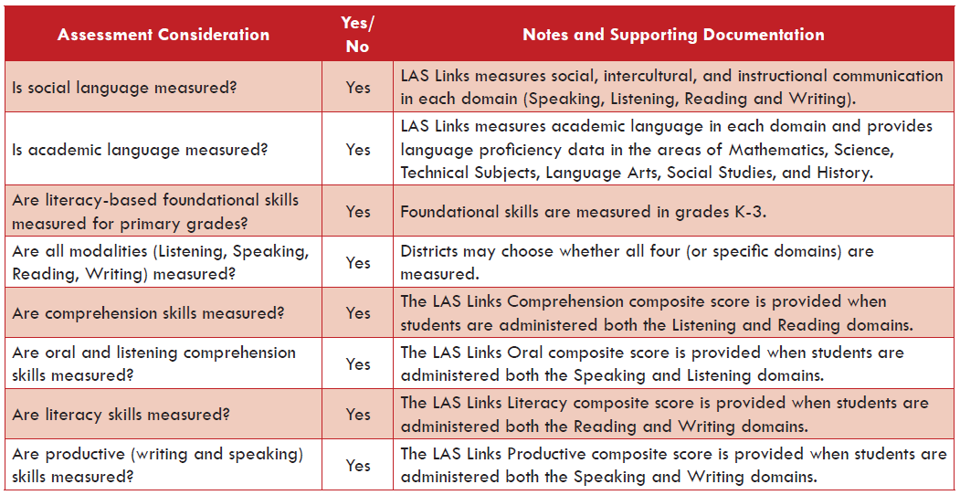
LAS Links Meets Important Criteria for
Progress Monitoring in New York
Notes:
In today’s session, we will address the following topics: (read topics or say:)
An overview of the DRC INSIGHT Testing System
We will go through the DRC INSIGHT Installation process as well as review some of the features for monitoring and managing the environment
And then we will review the additional technical resources

Slide 10
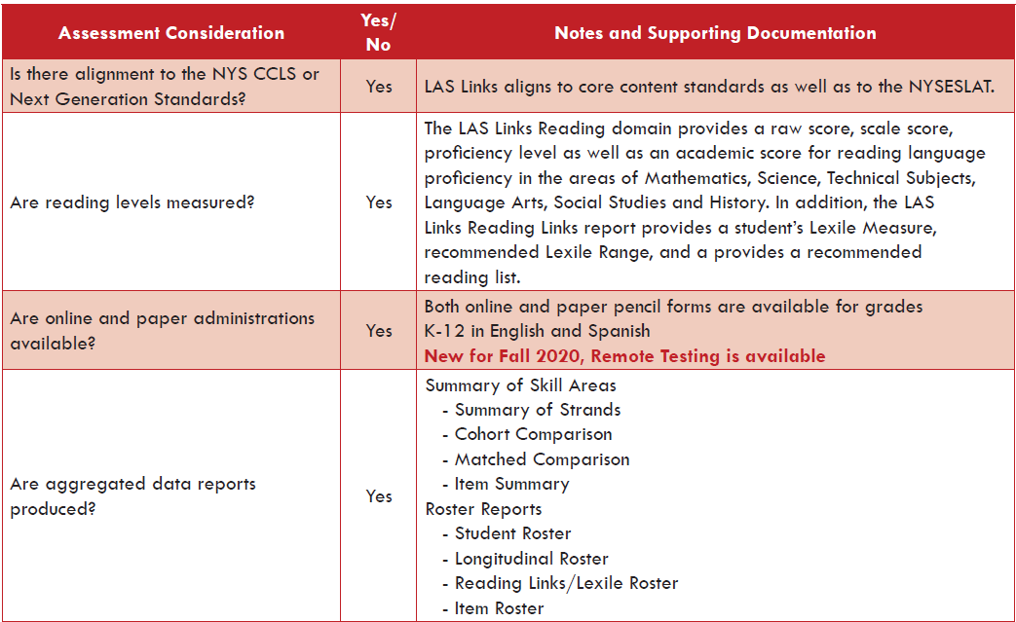
LAS Links Meets Important Criteria for
Progress Monitoring in New York
Notes:
In today’s session, we will address the following topics: (read topics or say:)
An overview of the DRC INSIGHT Testing System
We will go through the DRC INSIGHT Installation process as well as review some of the features for monitoring and managing the environment
And then we will review the additional technical resources

Slide 11
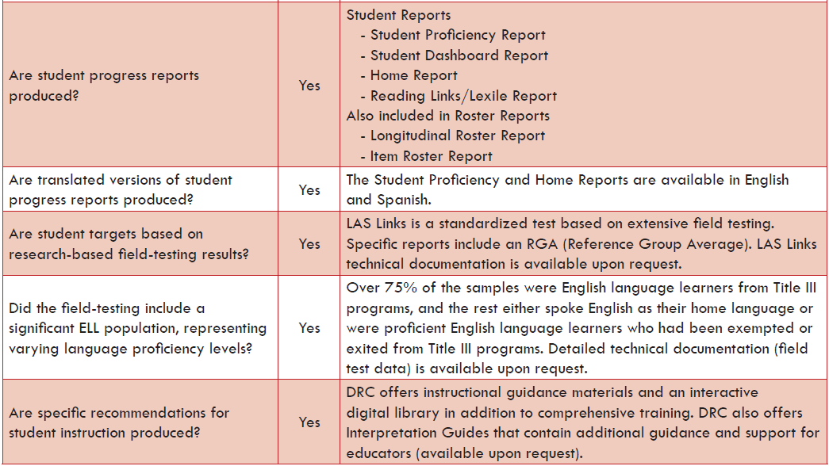
LAS Links Meets Important Criteria for
Progress Monitoring in New York
Notes:
In today’s session, we will address the following topics: (read topics or say:)
An overview of the DRC INSIGHT Testing System
We will go through the DRC INSIGHT Installation process as well as review some of the features for monitoring and managing the environment
And then we will review the additional technical resources

Slide 12

Scoring and Reporting

Slide 13
LAS Links Score Types
Raw Scores, Scale Scores, Proficiency Levels
Listening, Speaking, Reading, and Writing
Composite Scores
Overall, Oral, Literacy
Comprehension, Production
Strand Scores for Each Domain
Social: Intercultural and Instructional communication
Academic: English Language Arts, Social Studies and History
Academic: Mathematics, Science and Technical Subjects

Slide 14

LAS Links Interactive Reports
Student Reports
Roster Reports
Summary Reports
Student Proficiency Report
Student Dashboard Report
Home Report
Reading Links/Lexile Report
Student Roster
Longitudinal Roster
Reading Links/Lexile Roster
Item Roster
Summary of Skill Areas
Summary of Strands
Cohort Comparison
Matched Comparison
Item Summary
Notes:
Rachel

Slide 15
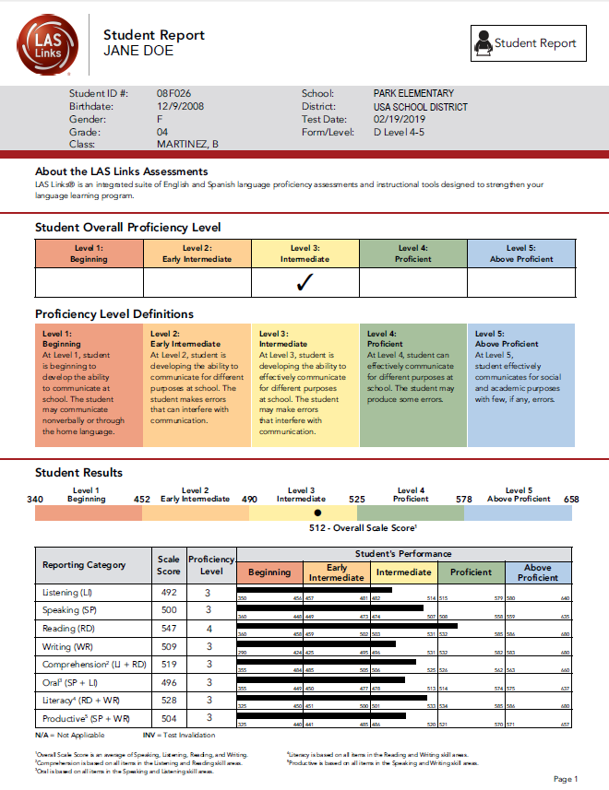
Student Proficiency Report
PAGE 1
Indicates Overall Proficiency Level
Proficiency Level Definitions provides stakeholders with information about each level
Shows Scale Score and Proficiency Level for each domain and composite score as well as where “in the level” the student is performing

Slide 16
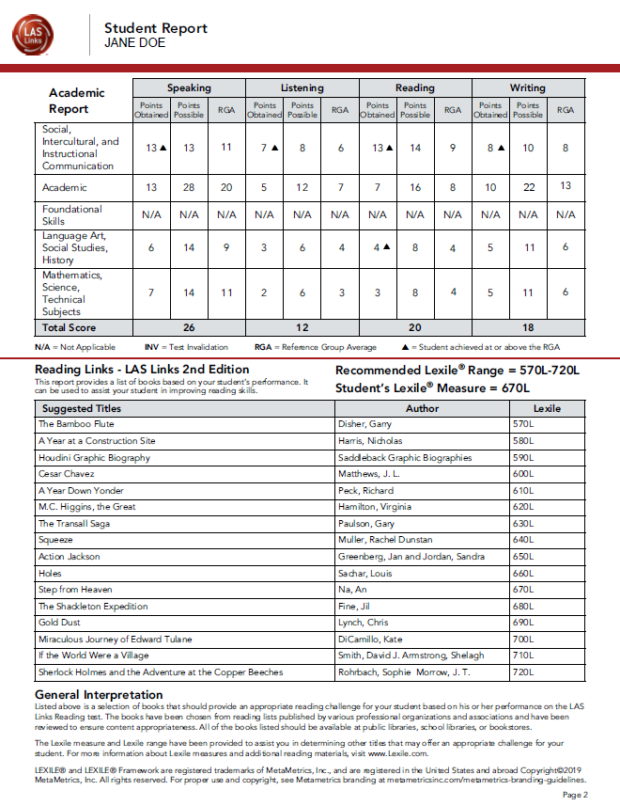

Student Proficiency Report
PAGE 2
Provides academic strand scores
Total Score is the total scored for that particular domain (i.e. Speaking)
Reading Links = Lexile Report

Slide 17
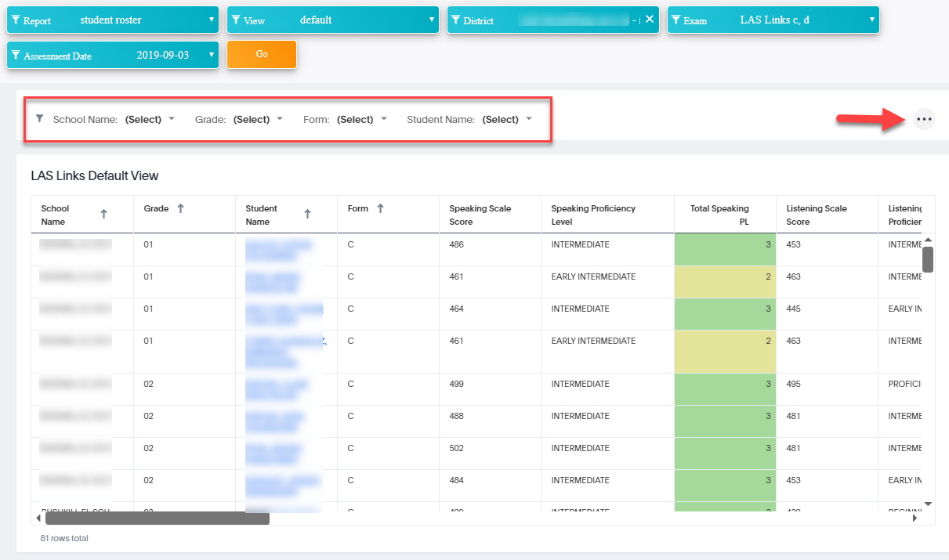
The Default Student Roster Report
Pick your fields: Exam, Assessment date, click Go
Click here to export this report
You may filter by using these tabs
Student names hyperlink to individual student proficiency reports

Slide 18
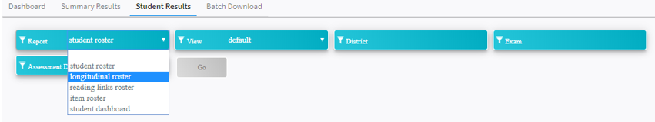
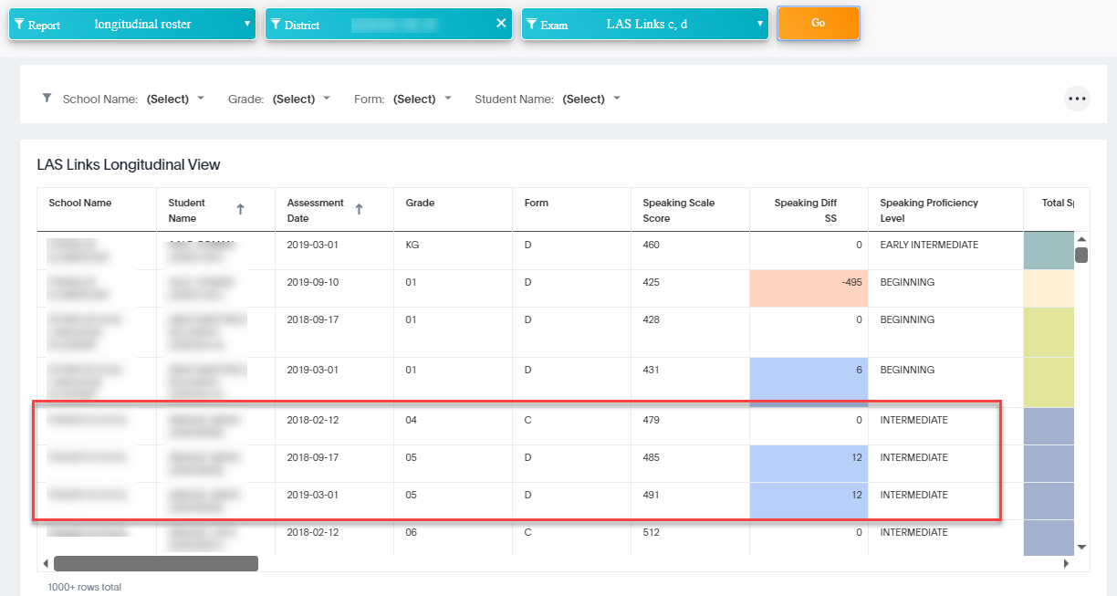
The Longitudinal Roster Report
All testing events auto populate
All SS diff auto populate
Same student over 3 testing events

Slide 19
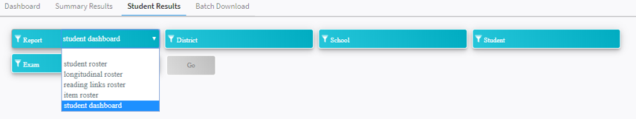
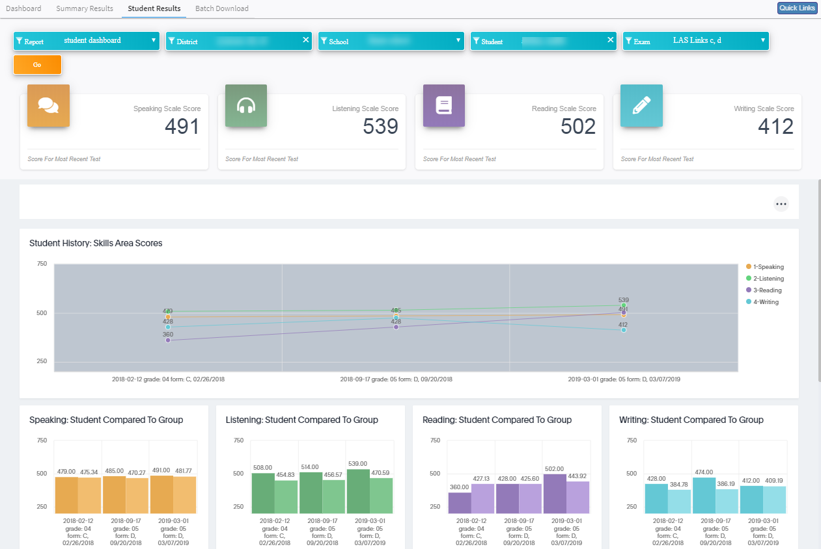
The Student Dashboard Report
All testing events auto populate for an individual student
click on any domain to remove it from the graph.
Same student over 3 testing events

Slide 20
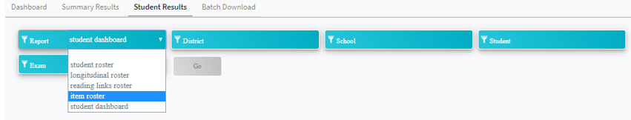
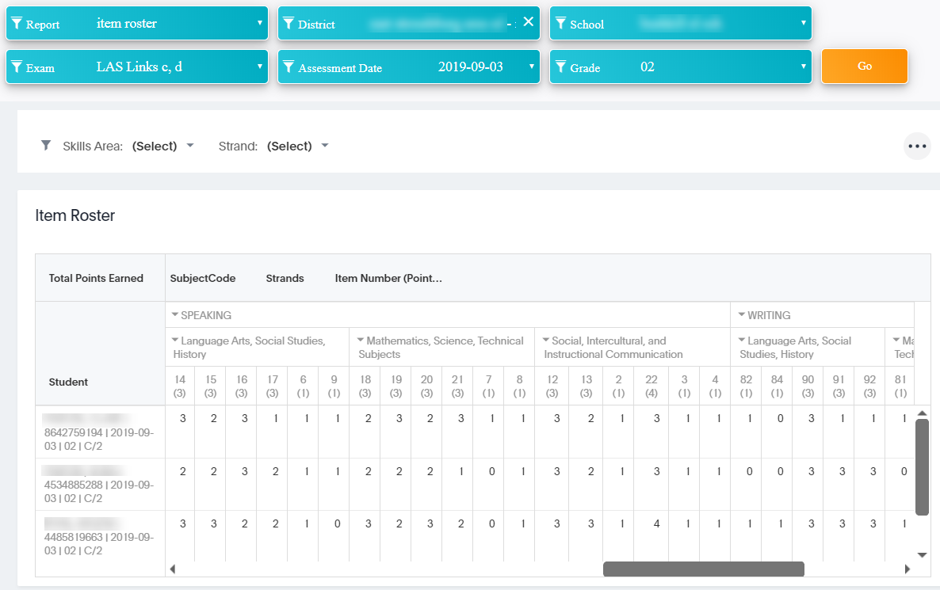
The Item Roster Report
Allows you to analyze student performance on each item

Slide 21
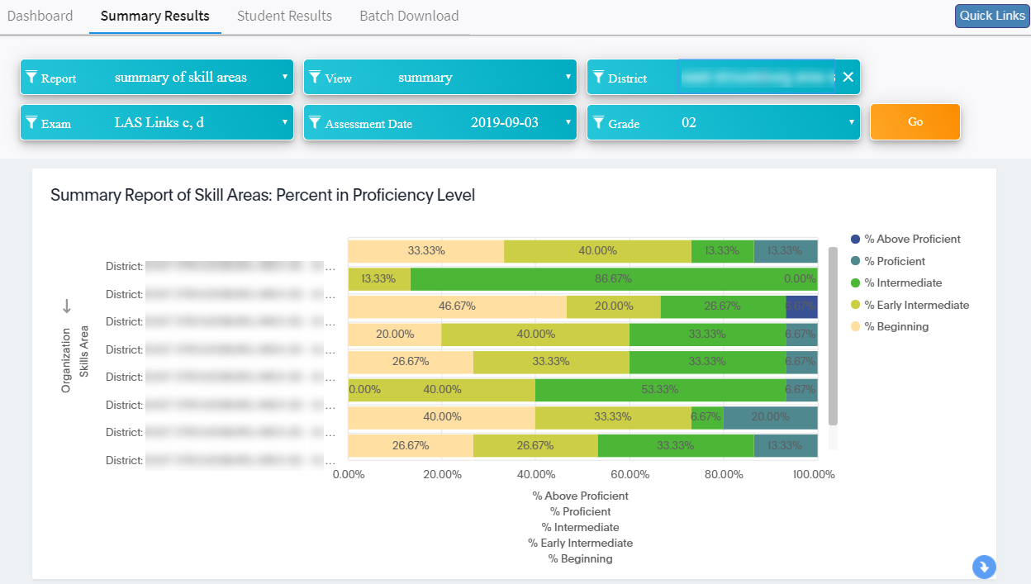
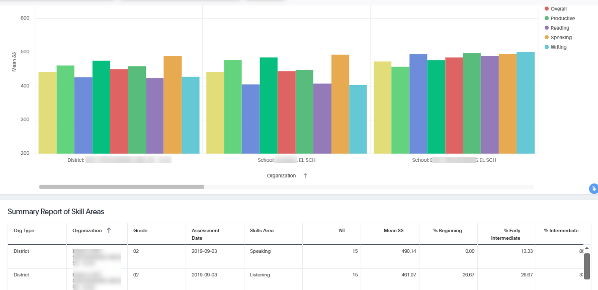
Summary of Skill Areas
Allows you to analyze grades as a whole throughout the district and/or school by school.
Each bar provides additional data when hovered over.

Slide 22
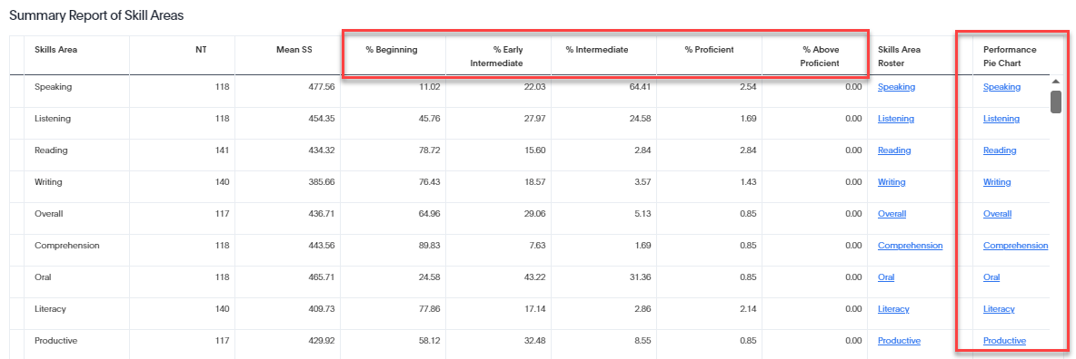
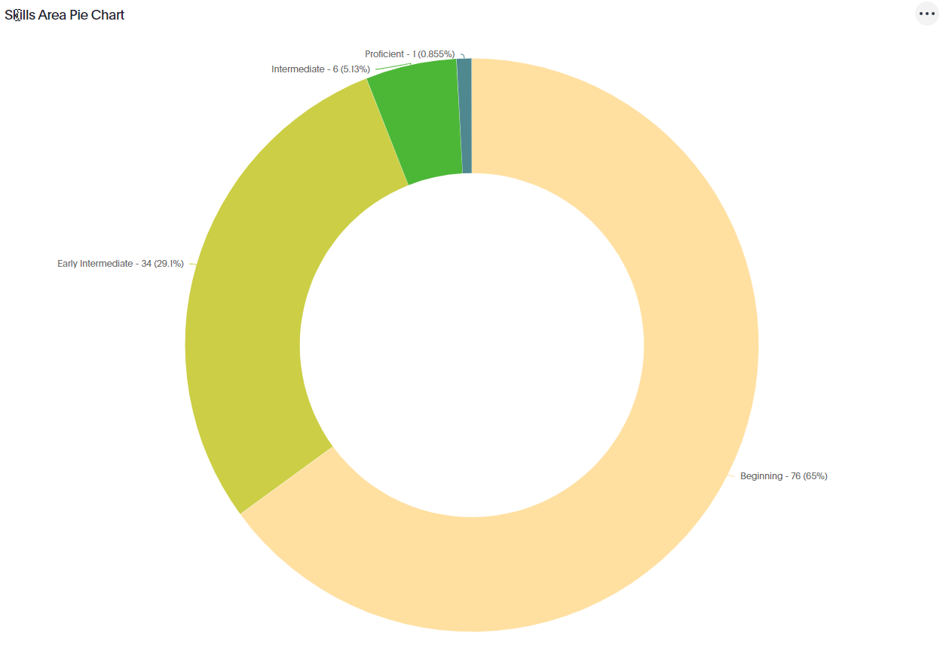
Summary of Skill Areas - continued
Scroll down to find the summary list of skill areas
Provides the percentage of students in each proficiency level across a grade in a district and/or school for the testing event/date chosen.
Click on the hyperlink under the performance pie chart for a graphic representation of this same information.

Slide 23
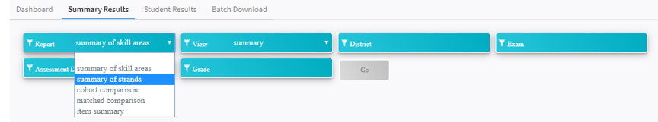
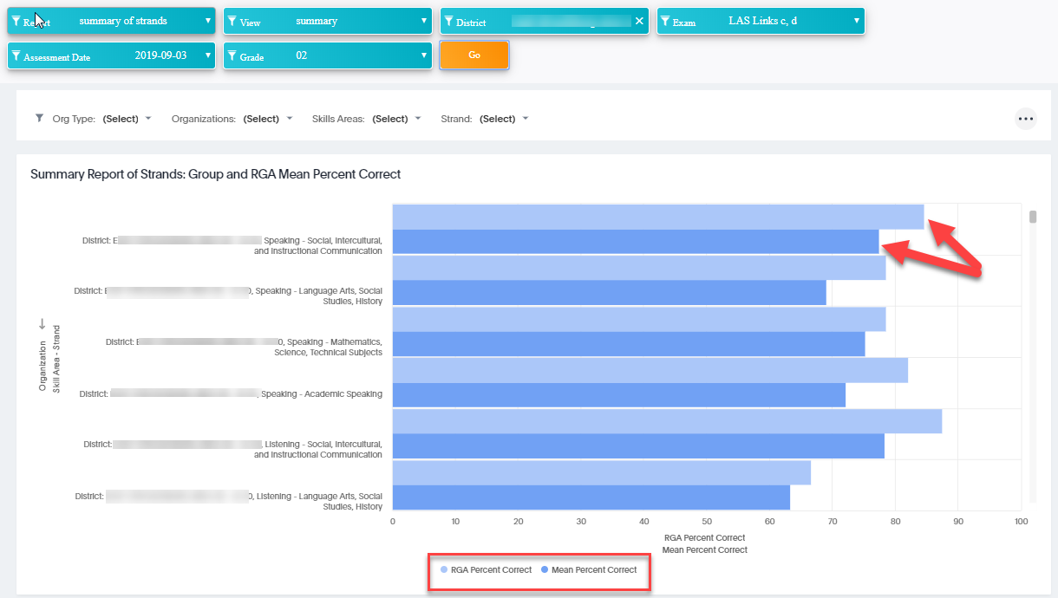
Summary of Strands
This group of 2nd graders is performing below the RGA in this strand
RGA = Reference Group Average

Slide 24
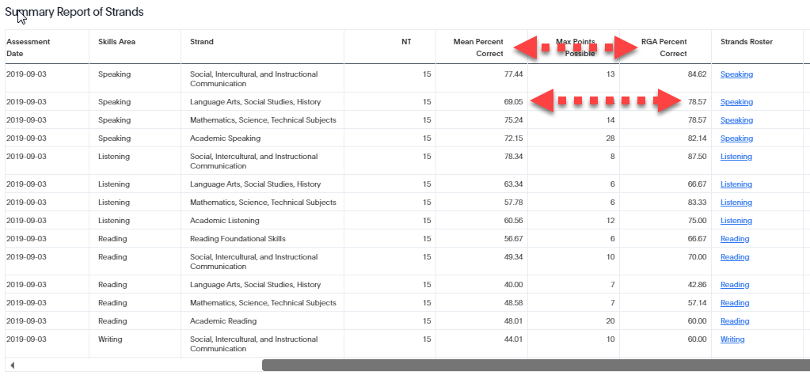
Summary of Strands – Roster View
Scroll down to find the summary list of strands

Slide 25
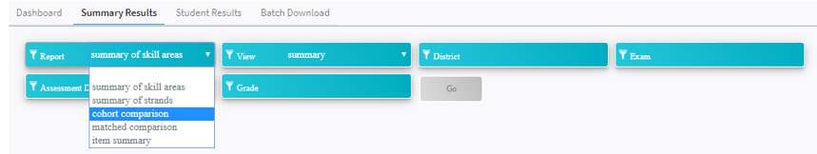
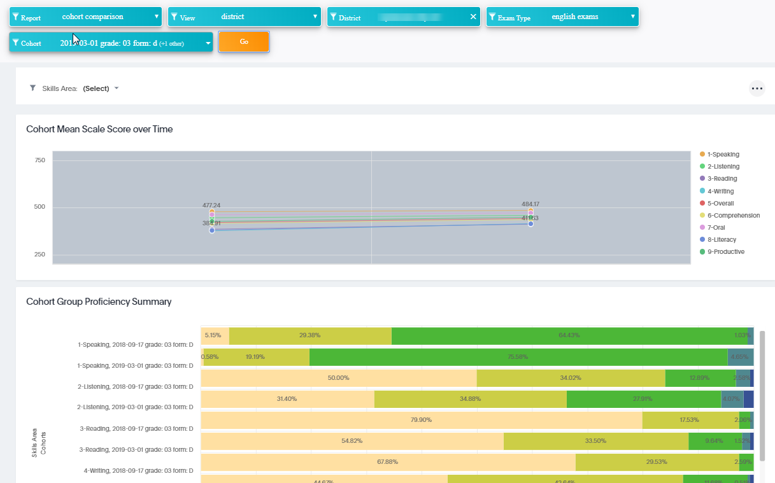
Cohort comparison report
click on any domain to remove it from the graph.
Same cohort over two testing events

Slide 26
Resources
Laslinks.com
LAS-NYSESLAT Alignment
LAS Links Digital Library
LAS Links Online Practice Test
LAS Links Online FAQ
LAS Links Guidance for Remote Testing

Slide 27
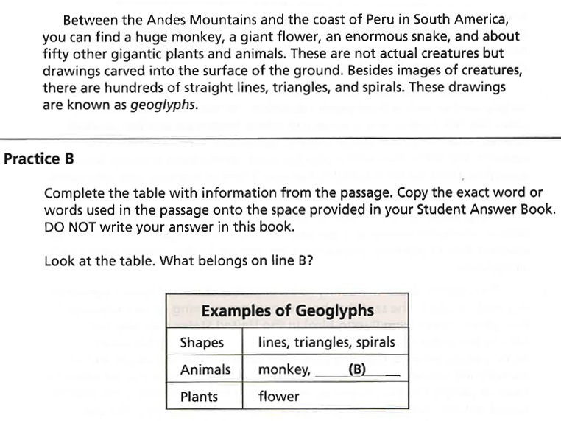

Items are contextualized in content areas
rather than the student’s knowledge of content
Notes:
Michele
This is a sample live test item which shows an example of how the LAS Links test items are contextualized in content areas rather than the students knowledge of the content. The goal for this student response is to select animals and plants and enter these items in the below table, rather than assessing the student’s content knowledge.

Slide 28
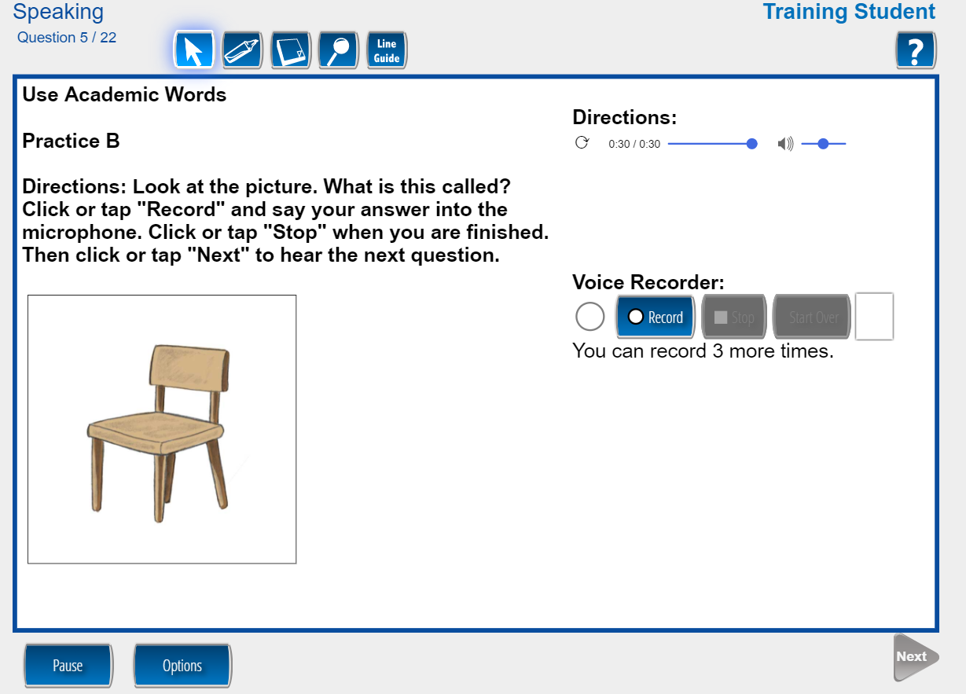
Student Experience: Speaking
The volume can be adjusted at any time
Click the record button to record
Notes:
Michele
If a student inadvertently mutes the microphone by clicking mute on the headset, the computer cannot recognize sound and the student may give a response that goes unrecorded. Be careful not to mute the microphone.
Students can click “start over” one time to re-record their answer.
Students can have the question repeated one time.

Slide 29
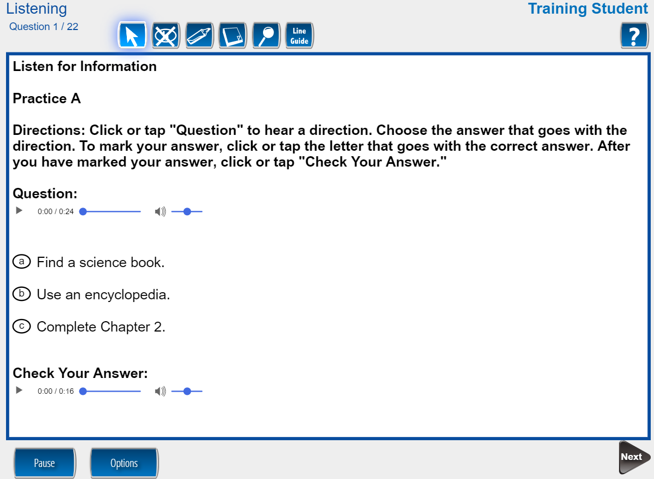
Click play to hear the question.
Check Your Answer on practice items is optional.
Once the student is done with a question, they click Next to move to the next question.
Notes:
Michele
The student will click to hear the question. They will select their answer and then, if they choose, they will click to “check your answer”. This is an optional feature.
Once a student is done with an item, they click “Next” to move to the next item.

Slide 30
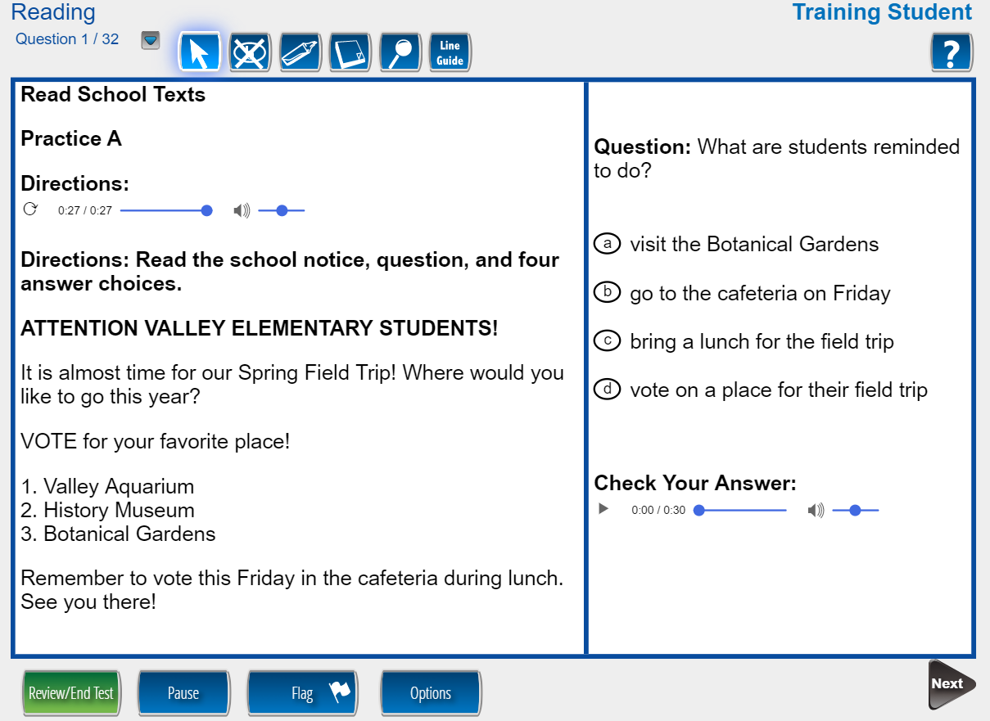
Students listen to the audio directions for the section then read the prompt and answer the questions at their own pace.
Notes:
Michele
Within the Reading subtest, in most cases, the Directions will auto play. To replay, click the replay button as soon as it becomes available. This will be after the audio has fully played the first time.
Students should click PAUSE if they need a break. Pausing allows the student to resume where they left off.

Slide 31
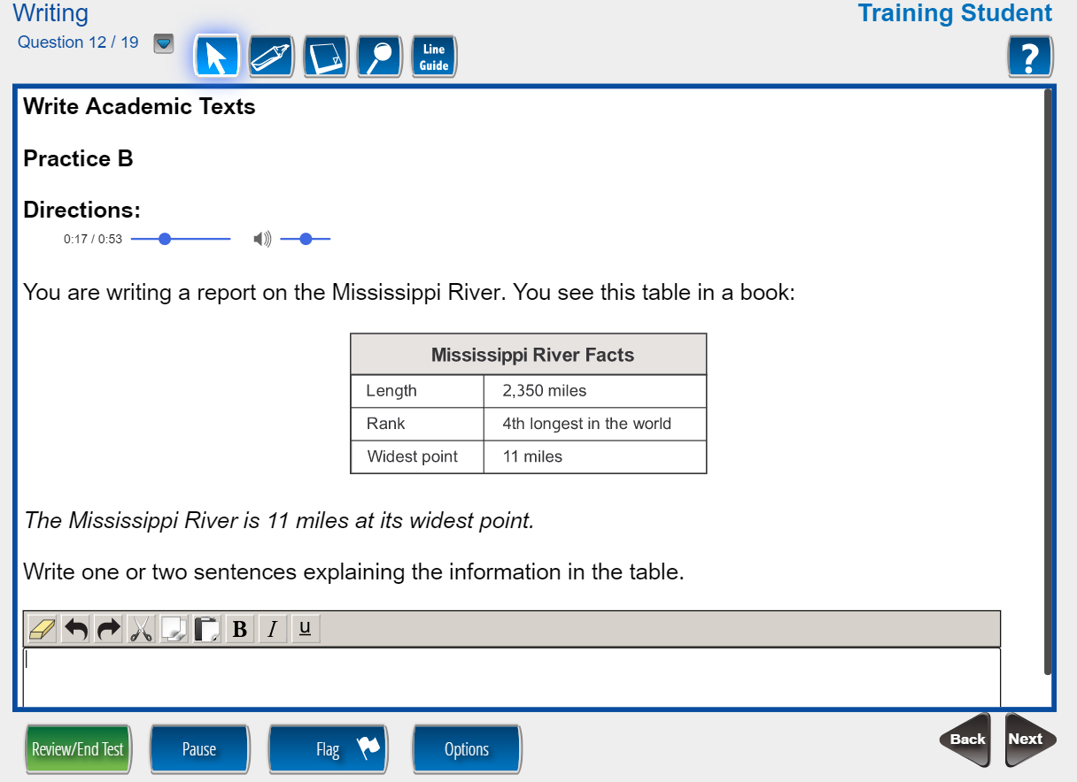
Student uses the keyboard and types their answer(s) into the box.
Notes:
Michele
Within the writing subtest, Student will use the keyboard and type their answer(s) into the box.

Slide 32
Maxine McCormick
DRC Assessment Consultant
609-354-2500 mmccormick@datarecognitioncorp.com

